Slide 1

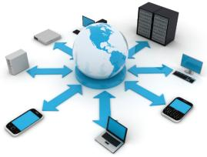

2160710
Distributed Operating System
Unit-1
Introduction to Distributed Systems
Prof. Rekha K. Karangiya
9727747317
Rekha.karangiya@darshan.ac.in

Slide 2
Syllabus
Unit No. | Unit Name | % Weightage
1 | Introduction to distributed Systems | 15
2 | Communication in distributed System | 05
3 | Synchronization in distributed systems | 10
4 | Processes and processors in distributed systems | 10
5 | Distributed File Systems | 10
6 | Distributed Shared Memory | 15
7 | Naming | 10
8 | Distributed Web-based Systems | 10
9 | Security | 10
10 | Case Study | 05

Slide 3
Reference Books
Distributed Operating Systems Concepts and Design, Pradeep K. Sinha, PHI
Distributed Operating Systems by Andrew S Tannebaum, Pearson

Slide 4
Topics to be covered
Introduction
Operating System
Basic Concepts of Distributed Operating System
Definition and Goal
Advantage
Hardware and Software Concepts
Design Issues

Slide 5
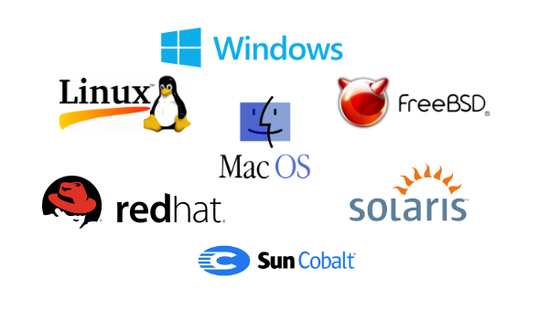
What is Operating System?
An operating system (OS) is system software that manages computer hardware and software resources and provides common services for computer programs.
Example:

Slide 6
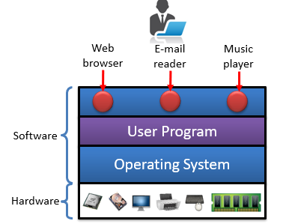
What is Operating System?
It is a program that acts as an interface between the user and the computer hardware and controls the execution of all kinds of programs.
User
User 1
User 2
Software
System Software
Application Software
Operating System
Windows
Linux
User 3
Mac
Hardware
CPU
RAM
I/O

Slide 7
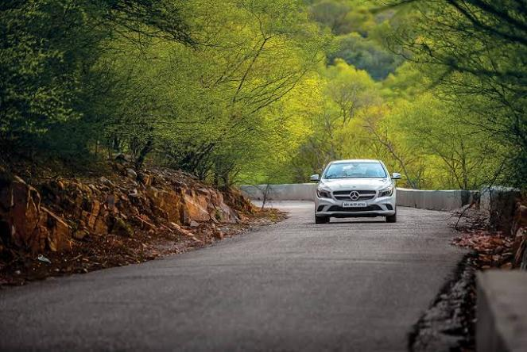
OS Example
Regular OS
When you want to do your own thing without interacting with others.
Simple (No rules to follow).

Slide 8
Evolution of Modern OS
First Generation OS
System:
Centralized OS
Characteristics:
Process Management
Memory Management
I/O Management
File Management
Goals:
Resource Management

Slide 9

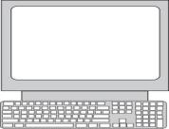
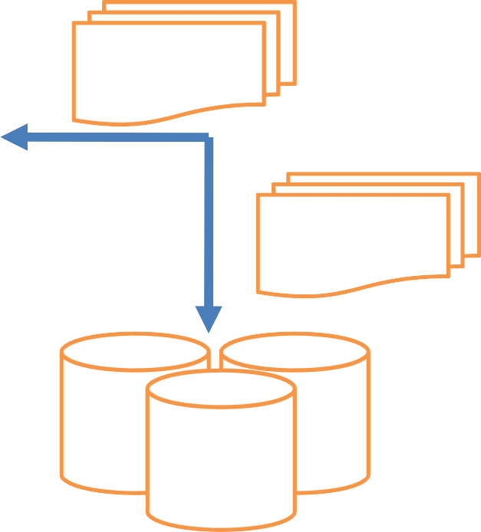
Centralized OS
Memory
T1
P1
P2
P3
P4
F1
F2
T2
D2
D3
D1
Management of processes, P1, P2, P3, P4 Management of memory, Memory Management of disks, D1, D2, D3 Management of files, F1, F2 Management of terminals, T1, T2, T3
T3
Centralized OS

Slide 10
Evolution of Modern OS
Second Generation OS
System:
Network OS(NOS)
Characteristics:
Remote access
Information exchange
Network browsing
Goals:
Interoperability-Sharing of resources between the systems.

Slide 11
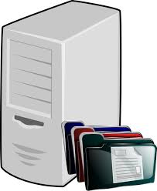

Network Operating System
File Server
Client-1
Client-2
Request
Reply
Network

Slide 12
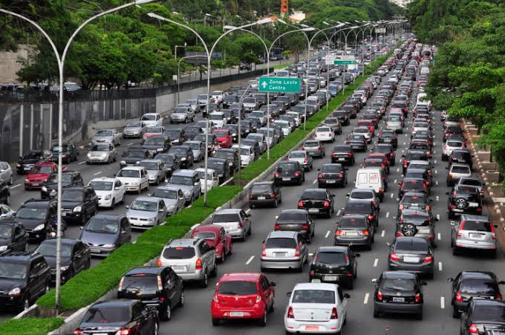
NOS Example
When you want to interact with others.
Introduces Network.
Hard compared to regular OS (have to follow rules E.g., traffic rules).

Slide 13

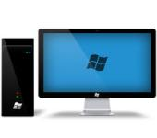

NOS Example
Printer connected to a computer
Printer
Print Server
Print
×
Print
Client-1
Client-2
Client-3
Client-4

Slide 14
Evolution of Modern OS
Third Generation OS
System:
Distributed OS(DOS)
Characteristics:
Global View of Computational power, file system, name space, etc.
Goals:
Single computer view of multiple heterogeneous computer systems.

Slide 15



Distributed Operating System
“A Distributed system is collection of independent computers which are connected through network.”
Systems processors are differ in size and functions
Communication Network

Slide 16
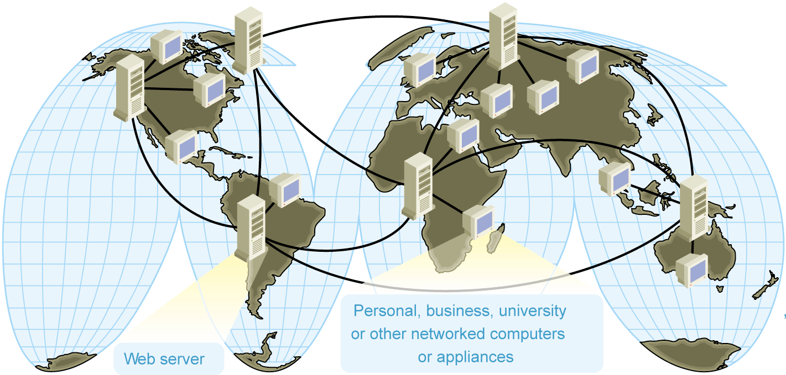
Distributed Operating System
Definition by Coulouris, Dollimore, Kindberg and Blair
“A distributed system is defined as one in which components at networked computers communicate and coordinate their actions only by passing messages.”
“A Distributed system is collection of independent computers which are connected through network.”

Slide 17

Distributed Operating System
A great example of distributed system is the web page of Darshan college.
Internet
www.darshan.ac.in
User
Web Server
Mechanical Department
Computer Department

Slide 18
Scenario-1:
Want to process 500GB Data
Increase RAM size to 8GB
RAM: 4GB
RAM: 8GB
Vertical Scaling

Slide 19
Scenario-2:
Want to process 500GB Data
RAM: 4GB
Add more Processors/Systems
DOS
RAM: 4GB
RAM: 4GB
RAM: 4GB
Divide/Distribute the workload
Horizontal Scaling

Slide 20
Examples of Distributed Systems
From the definition, Distributed Systems also looks the same as single system.
Let us say about Google Web Server, from users perspective while they submit the searched query, they assume google web server as a single system.
Just visit google.com, then search.
However, under the hood Google builds a lot of servers even distributes in different geographical area to give you a search result within few seconds.
So the Distributed Systems does not make any sense for normal users.

Slide 21
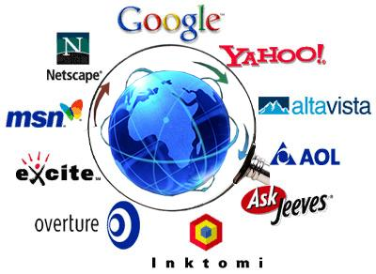
Examples of Distributed Systems
Web Search Engines:
Major growth industry in the last decade.
10 billion per month for global number of searches.
e.g. Google distributed infrastructure

Slide 22
Examples of Distributed Systems
Massively multiplayer online games:
Large number of people interact through the Internet with a virtual world.
Challenges include fast response time, real-time propagation of events.

Slide 23
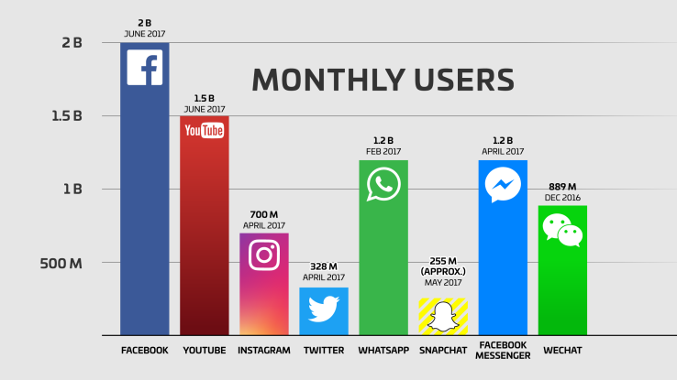
The Top 20 Valuable Facebook Statistics (Zephoria, Updated Dec., 2017)

Slide 24
Why Distributed Operating System?
Facebook, currently, has 1.5 billion active monthly users.
Google performs at least 1 trillion searches per year.
About 48 hours of video is uploaded in Youtube every minute.
A single system would be unable to handle the processing. Thus, comes the need for Distributed Systems.
The main answer is to cope with the extremely higher demand of users in both processing power and data storage.
With this extremely demand, single system could not achieve it.
There are many reasons that make distributed systems is viable such as high availability, scalability, resistant to failure, etc.

Slide 25
Why Distributed Operating System?
It is Challenging/Interesting.
Partial Failures
Network
Node failures
Concurrency
Nodes execute in parallel.
Messages travel asynchronously.
Parallel Computing

Slide 26
Network OS vs Distributed OS
Network Operating System | Distributed Operating System
A network operating system is made up of software and associated protocols that allow a set of computer network to be used together. | A distributed operating system is an ordinary centralized operating system but runs on multiple independent CPUs.
Environment users are aware of multiplicity of machines. | Environment users are not aware of multiplicity of machines.
Control over file placement is done manually by the user. | It can be done automatically by the system itself.
No implicit sharing of loads. | Sharing of loads between nodes(load balancing).

Slide 27
Network OS vs Distributed OS
Network Operating System | Distributed Operating System
Performance is badly affected if certain part of the hardware starts malfunctioning. | It is more reliable or fault tolerant i.e. distributed operating system performs even if certain part of the hardware starts malfunctioning.
Remote resources are accessed by either logging into the desired remote machine or transferring data from the remote machine to user's own machines. | Users access remote resources in the same manner as they access local resources.

Slide 28
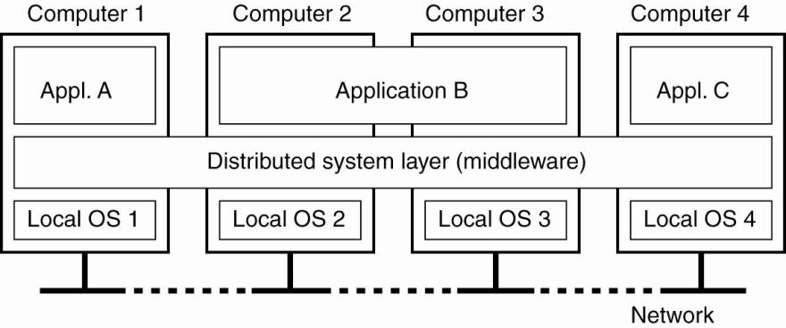
Distributed Operating System Architecture
A distributed system organized as Middleware.
The middleware layer runs on all machines, and offers a uniform interface to the system.

Slide 29
Middleware (MW)
Software that manages and supports the different components of a distributed system. In essence, it sits in the middle of the system.
It enables multiple systems to communicate with each other across different platforms.
Examples:
Transaction processing monitors
Data converters
Communication controllers

Slide 30
Role of Middleware (MW)
In some early systems:
Middleware tried to provide the illusion that a collection of separate machines was a single computer.
Today:
Clustering software allows independent computers to work together closely.
Middleware also supports seamless access to remote services, doesn’t try to look like a general-purpose OS.

Slide 31
Role of Middleware (MW)
Other Middleware Examples
CORBA (Common Object Request Broker Architecture)
DCOM (Distributed Component Object Management) – being replaced by .NET
Sun’s ONC RPC (Remote Procedure Call)
RMI (Remote Method Invocation)
SOAP (Simple Object Access Protocol)

Slide 32


Distributed System Goals
The following are the main goals of distributed systems:
The relative simplicity of the software - Each processor has a dedicated function.
Incremental growth - If we need 10 percent more computing power, we just add 10 percent more processors.

Slide 33





Distributed System Goals
Reliability and availability - A few parts of the system can be down without disturbing people using the other parts.
Openness: Multiple computers of different types, operating systems and manufacturers can interact together in a simple system.

Slide 34
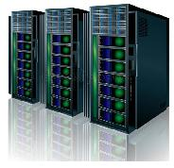


Advantages of Distributed Systems over Centralized Systems
Economics: A collection of microprocessors offer a better price/performance than mainframes. It is an cost effective way to increase computing power.
Speed: A distributed system may have more total computing power than a mainframe.

Slide 35
Advantages of Distributed Systems over Centralized Systems
Inherent distribution: Some applications are inherently distributed. Ex. a supermarket chain, Banking, Airline reservation.
Reliability: If one machine crashes, the system as a whole can still survive. Higher availability and improved reliability.
Ex. control of nuclear reactors or aircraft.
×
Load Transfer

Slide 36

Advantages of Distributed Systems over Independent PCs
Data sharing: Allow many users to access to a common database.
Resource Sharing: Expensive peripherals such as color laser printers, photo-type setters and massive archival storage devices are also among the few things that should be sharable.
Communication: Enhance human-to-human communication, e.g., email, chat.
Flexibility: Spread the workload over the available machines

Slide 37
Disadvantages of Distributed Systems over Centralized System
Software:
Would be complex.
Network problem:
Network saturation.
Malfunctioning of network.
Security:
Possibility of security violation since the private data are visible to others over the network.

Slide 38
Classification of Distributed System
Based on Hardware
Based on number of instructions and DataStream

Slide 39
Classification based on Hardware
Even though all distributed system consist of multiple CPUs, there are several different ways the hardware can be organized, specially in terms of how they are interconnected and communicate.
Parallel & Distributed Computers
Tightly Coupled
Loosely Coupled
Multiprocessor (Shared Memory)
Multicomputer
(Private Memory)
Bus based
Switched
Bus based
Switched

Slide 40

Tightly-Coupled OS(Shared Memory)
Shared Memory Machine: The n processors shares physical address space. Communication can be done through shared memory.
P
P
P
P
Interconnect (Bus Line)
Shared Memory

Slide 41
Tightly-Coupled OS(Shared Memory)
Shared Memory Machine: The n processors shares physical address space. Communication can be done through shared memory.
Read A
A=A+10
A=20
A=10+10
A=20
P
P
P
P
Interconnect (Bus Line)
A=10
A=20
A=20
10

Slide 42
Loosely-Coupled OS(Private Memory)
Private Memory Machine: Each processors has its own local memory. Communication can be done through Message passing.
M
M
M
M
P
P
P
P
Interconnect (Bus Line)

Slide 43
Loosely-Coupled OS(Private Memory)
Private Memory Machine: Each processors has its own local memory. Communication can be done through Message passing.
M
M
M
M
A=10
A=20
Read A
P
P
P
P
Read A
Read A
A=20
Interconnect (Bus Line)

Slide 44
Classification based on Hardware
Loosely-Coupled OS | Tightly-Coupled OS
Each processors has its own local memory. | The n processors shares physical address space.
Communication can be done through Message passing. | Communication can be done through shared memory.
Manages heterogeneous multicomputer Distributed Systems. | Manages multiprocessors & homogeneous multicomputer.
Similar to “local access feel” as a non-distributed, standalone OS. | Provides local services to remote clients via remote logging

Slide 45
Classification based on Hardware
Loosely-Coupled OS | Tightly-Coupled OS
Data migration or computation migration modes (entire process or threads) | Data transfer from remote OS to local OS via FTP (File Transfer Protocols)
Distributed Operating System (DOS) | Network Operating System (NOS)

Slide 46
Classification based on Instruction & DataStream
According to Flynn’s classification can be done based on the number of instruction streams and number of data streams.
Flynn’s Classification
SISD
SIMD
MISD
MIMD

Slide 47
Classification based on Instruction & DataStream
Single instruction stream single data stream (SISD)
One Program counter and one path to data memory.
A computer is capable of executing one instruction at a time operating on one piece of data.
An ordinary (Sequential) computer.
+
Instruction Pool
A B
Data Stream
PU

Slide 48
Classification based on Instruction & DataStream
Single instruction stream, multiple data streams (SIMD)
One Program counter and multiple paths to data memory.
A computer is capable of executing one instruction at a time, but operating on different pieces of data.
Instruction Pool
+
A B
+
PU
C D
+
Data Stream
PU
E F
PU

Slide 49
Classification based on Instruction & DataStream
Multiple instruction streams, single data stream (MISD)
No more computers fit this model.
Uncommon architecture which is generally used for fault tolerance.
Instruction Pool
+
*
A B
A B
Data Stream
PU
PU

Slide 50
Classification based on Instruction & DataStream
Multiple instruction streams, Multiple data stream (MIMD)
A group of independent computers, each with its own program counter, program, and data.
A computer that can run multiple processes or threads that are cooperating towards a common objective.
Instruction Pool
+
*
+
A B
A B
*
PU
PU
Data Stream
C D
C D
PU
PU

Slide 51
Classification based on Instruction & DataStream
All distributed systems are MIMD, We divide all MIMD computers into two groups:
Have shared memory, usually called multiprocessors.
Do not have shared memory, called multicomputer.

Slide 52
Distributed Computing System Models
Distributed Computing system models can be broadly classified into five categories.
Minicomputer Model
Workstation Model
Hybrid Model
Processor – Pool Model
Workstation – Server Model

Slide 53
Minicomputer Model
Extension of Time sharing system
User must log on his/her home minicomputer.
Thereafter, he/she can log on a remote machine by telnet.
Resource sharing
Database
High-performance devices
Example:
ARPAnet
Mini-Computer
T
T
Mini-Computer
Communication
Network
Mini-Computer
T
T
T
T

Slide 54
Workstation Model
Process migration
Users first log on his/her personal workstation.
If there are idle remote workstations, a heavy job may migrate to one of them.
Problems:
What if a user log on the remote machine
How to find an idle workstation
How to migrate a job
Workstation
Communication
Network
Workstation
Workstation
Workstation
Workstation

Slide 55
Workstation-Server Model
Workstation
Workstation
Workstation
Communication
Network
Workstation
Workstation
Mini Computer
Used as a
File Server
Mini Computer
Used as a
Print Server
Mini Computer
Used as a database Server

Slide 56
Workstation-Server Model
Client workstations
Diskless
Graphic/interactive applications processed in local.
All file, Print, http and even cycle computation requests are sent to servers.
Server minicomputers
Each minicomputer is dedicated to one or more different types of services.
Client-Server model of communication
RPC (Remote Procedure Call)
RMI (Remote Method Invocation)
A Client process calls a server process function.
No process migration invoked

Slide 57
Processor-Pool Model
Terminals
Terminals
Terminals
Communication
Network
Terminals
Terminals
Run
Server
File
Server
----------
Pool of processors

Slide 58
Processor-Pool Model
Clients:
They log in one of terminals (diskless workstations)
All services are dispatched to servers.
Servers:
Necessary number of processors are allocated to each user from the pool.
Better utilization of resources.
Example:
Web Search Engines

Slide 59
Hybrid Model
Advantages of the workstation-server and processor-pool models are combined to build a hybrid model.
It is built on the workstation-server model with a pool of processors.
Processors in the pool can be allocated dynamically for large computations, that cannot be handled by the workstations, and require several computers running concurrently for efficient execution.
This model is more expensive to implement than the hybrid or the processor-pool model.

Slide 60
Issues in Designing a Distributed System
Transparency
Reliability
Flexibility
Performance
Scalability
Heterogeneity
Security

Slide 61
Transparency
Main goal of Distributed system is to make the existence of multiple computers invisible (transparent) and provide single system image to user.
A transparency is some aspect of the distributed system that is hidden from the user (programmer, system developer, application).
While users hit search in google.com, They never notice that their query goes through a complex process before google shows them a result.

Slide 62
Types of Transparency
Access Transparency
Local and remote objects should be accessed in a uniform way.
User should not find any difference in accessing local or remote objects.
Hide differences in data representation & resource access (enables interoperability).
Example : Navigation in the Web
Location Transparency
Objects are referred by logical names which hide the physical location of the objects.
Resource should be independent of the physical connectivity or topology of the system or the current location of the resources.
Hide location of resource (can use resource without knowing its location).
Example: Pages in the Web

Slide 63
Types of Transparency
Replication Transparency
The provision of create replicas (additional copies) of files and other resources on different node of the distributed system.
Hide the possibility that multiple copies of the resource exist (for reliability and/or availability).
Replica of the files and data are transparent to the user.
Failure Transparency
It deals with the masking from the users partial failures in the system, such as a communication link failure, a machine failure, or a storage device crash.
Hide failure and recovery of the resource.
Example: Database Management System.

Slide 64
Types of Transparency
Migration Transparency
Resource object is to be moved from one place to another automatically by the system.
Hide possibility that a system may change location of resource (no effect on access).
Load balancing is one among many reason for migration of objects.
Concurrency Transparency
Each user has the feeling that he or she is the sole user of the system and other user do not exists in the system.
Hide the possibility that the resource may be shared concurrently.
Example: Automatic teller machine network, DBMS

Slide 65
Types of Transparency
Performance Transparency
It allow the system to be automatically reconfigured to improve performance, as load vary dynamically in the system.
Scaling
Transparency
It allows the system to expand in scale without disrupting the activities of the users.
Example: World-Wide-Web

Slide 66
Reliability
Distributed systems are expected to be more reliable than centralized systems due to the existence of multiple instances of resources.
System failure are of two types:
Fail-stop: The system stop functioning after detecting the failure.
Byzantine failure: The system continues to function but gives wrong results.
The fault-handling mechanism must be designed properly to avoid faults, to tolerate faults and to detect and recover from faults.

Slide 67
Reliability
Fault avoidance
Fault tolerance:
Redundancy technique: To avoid single point of failure.
Distributed control: To avoid simultaneous functioning of the servers.
Fault detection and recovery
Atomic transaction.
Stateless server.
Acknowledgment and timeout-based retransmissions of messages.

Slide 68
Flexibility
The design of Distributed operating system should be flexible due to following reasons:
Ease of Modification: It should be easy to incorporate changes in the system in a user transparent manner or with minimum interruption caused to the users.
Ease of Enhancement: New functionality should be added from time to time to make it more powerful and easy to use.
A group of users should be able to add or change the services as per the comfortability of their use.

Slide 69
Performance
A performance should be better than or at least equal to that of running the same application on a single-processor system.
Some design principles considered useful for better performance are as below:
Batch if possible: Batching often helps in improving performance.
Cache whenever possible: Caching of data at clients side frequently improves over all system performance.
Minimize copying of data: Data copying overhead involves a substantial CPU cost of many operations.
Minimize network traffic: It can be improved by reducing internode communication costs.

Slide 70
Scalability
Distributed systems must be scalable as the number of user increases.
Scalability has 3 dimensions:
Size: Number of users and resources to be processed. Problem associated is overloading.
Geography: Distance between users and resources. Problem associated is communication reliability.
Administration: As the size of distributed systems increases, many of the system needs to be controlled. Problem associated is administrative mess.
A system is said to be scalable if it can handle the addition of users and resources without suffering a noticeable loss of performance or increase in administrative complexity.

Slide 71
Scalability
Guiding principles for designing scalable distributed systems:
Avoid centralized entities.
Avoid centralized algorithms.
Perform most operations on client workstations.

Slide 72
Heterogeneity
This term means the diversity of the distributed systems in terms of hardware, software, platform, etc.
Modern distributed systems will likely span different:
Hardware devices: computers, tablets, mobile phones, embedded devices, etc.
Operating System: Ms Windows, Linux, Mac, Unix, etc.
Network: Local network, the Internet, wireless network, satellite links, etc.
Programming languages: Java, C/C++, Python, PHP, etc.
Different roles of software developers, designers, system managers.

Slide 73
Security
System must be protected against destruction and unauthorized access.
Enforcement of security in a distributed system has the following additional requirements as compared to centralized system:
Sender of the message should know that message was received by the intended receiver.
Receiver of the message should know that the message was sent by genuine sender.
Both sender and receiver should be guaranteed that the content of message were not changed while it is in transfer.

Slide 74
Brief (Issues in Designing a Distributed System)
Transparency
Provide a single system image to its user.
Reliability
Degree of Fault tolerance should be low.
Flexibility
Ease of Modification and Enhancement.
Performance
Performance should be better than Centralized system.
Scalability
Capability of a system to adopt increased service load.
Heterogeneity
It consist of dissimilar hardware or software systems.
Security
Must be protected against destruction and unauthorized access.

Slide 75
End of Unit-1
Unit 1: Introduction to DOS 75 Darshan Institute of Engineering & Technology

